Slide 1


Analysis of Olist E-Commerce
Olist
SC1015 B140_Team3
Kiew Ten Wei & Lester Kwek
Notes:
Hello everyone, I am Lester and together with my groupmate Ten Wei, we will be presenting on our in depth analysis on the e-commerce platform called Olist, which is based in Brazil.

Slide 2
Table of contents
PAY
01
Problem statement
02
Data Cleaning
03
Exploration Analysis
04
Machine Learning
05
Insights
06
Conclusion
Notes:
Here’s the table of contents we will be presenting on. Firstly, we will be talking about the problem statement that we have formulated before moving on the steps that we took during our Data Cleaning process. There would then be a brief discussion on the exploratory data analysis of the datasets we worked on, supported by visual evidence. Following up next, we will be showcasing the machine learning model that we have adopted for this project. Lastly, we will be presenting our key findings and insights before concluding this presentation.

Slide 3
Problem statement
Hypothesis:
The customer review rating may be influenced by the customer's actions and how the order is handled.
Question:
What rating or score will customers provide in their reviews?
Notes:
So our group has identified that the customer review scores may be affected by each and every customers’ behaviour and also on how the order is being fulfilled. Thus, our group has come up with the problem statement - what review scores will the customers be giving?

Slide 4
Data Cleaning
Remove Irrelevant Data
Converting the format of datetime
Merge datasets
Null values are being cleared
Timestamps need to be converted to correct date time format
Merging datasets based on their common columns
Notes:
Moving on to Data Cleaning, there are 3 main procedures that we did to ensure the quality of the data is being preserved. Firstly, we removed bad data such as null values and also incorrect data that are being recorded. Second, we converted the timestamps to datetime format before we are able to use them in our codes. Finally, we merged the multiple cleaned datasets by identifying common columns.

Slide 5
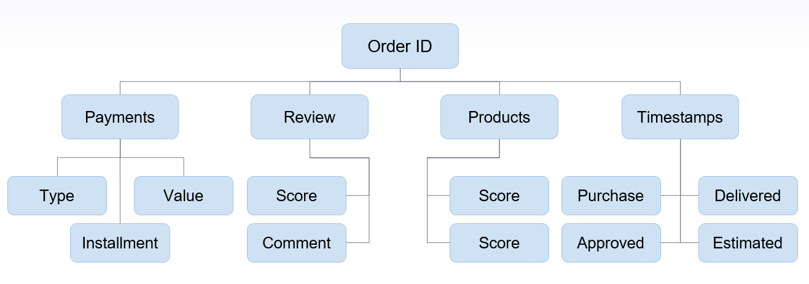
Data Cleaning
Merged datasets according to common columns:
Notes:
As shown in the slide the different datasets have a common column, which is the Order ID. This way, multiple datasets can be merged together into a single dataset for easier comparison.

Slide 6

Exploratory Data Analysis
Basic Data
Users
96,096
Sellers
3,095
Items
31,630
Mean Seller Revenue
$6,597
Item Categories
71
Days
772
Notes:
Moving on to Exploratory Data Analysis, here are the basic statistics of the datasets that our team has managed to get out of the datasets.

Slide 7
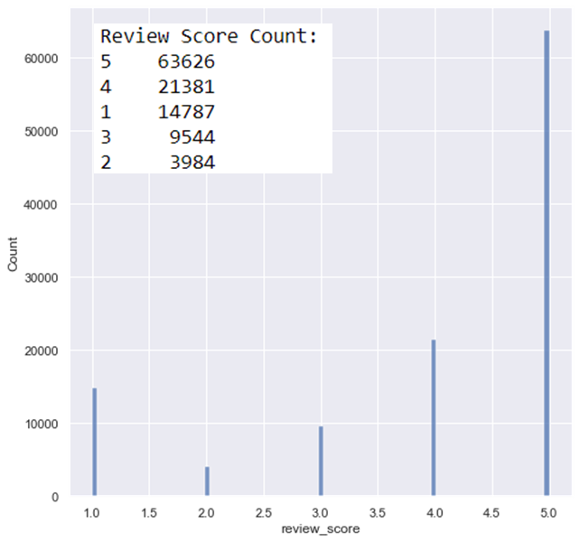
Exploratory Data Analysis
Notes:
Next up, this graph summarises the total count of products for each review rating given, with most products being given a max rating of 5 star.

Slide 8
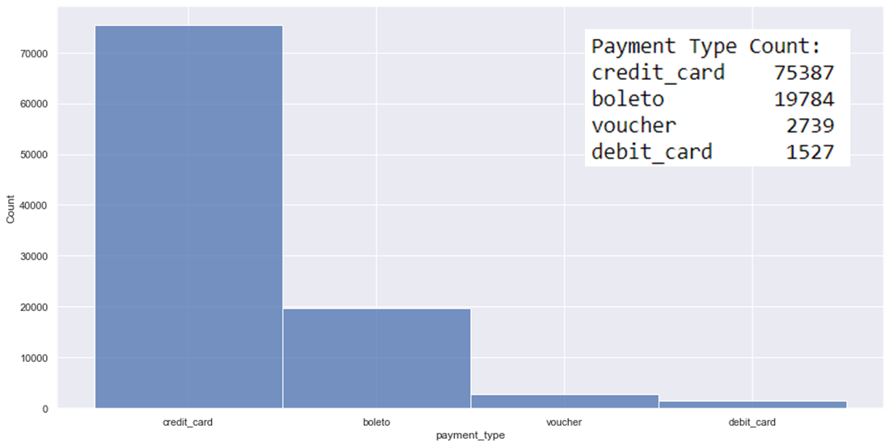
Exploratory Data Analysis
Notes:
Another interesting to note would be that the most preferable mode of payment is via credit card, then followed by boleto, which is another mode of payment exclusively in brazil that is being regulated by the Brazil Federation of Banks.

Slide 9
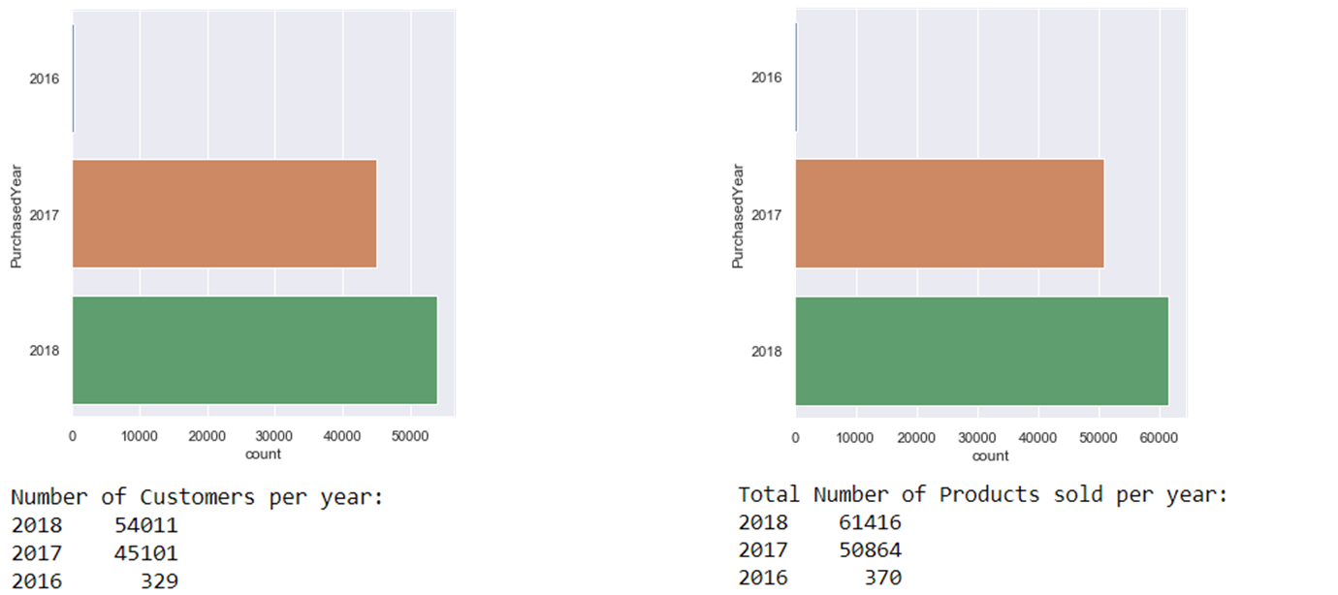
Exploratory Data Analysis
Customers:
Products:
< 2 products bought per customer
Notes:
The graph on the left shows the number of customers purchasing on the ecommerce platform per year, whereas the graph on the right shows the number of products being sold on the ecommerce site per year. From the figures above, we can deduce that on average, each customer only bought less than 2 products per year.

Slide 10
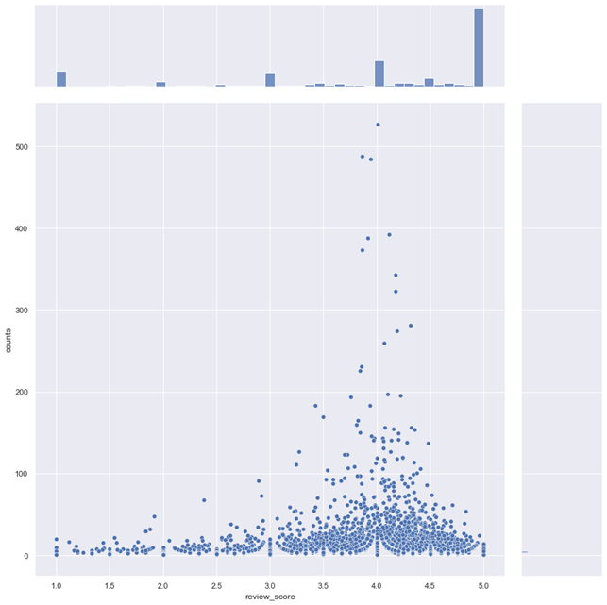
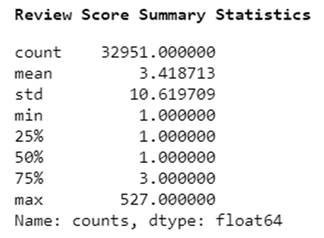
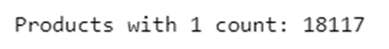
Exploratory Data Analysis
Notes:
Initially, we plotted the sales count for each unique product against its mean review score as shown in the graph.
We observed that there was no strong correlation due to more than half of the unique products having only one sales count

Slide 11
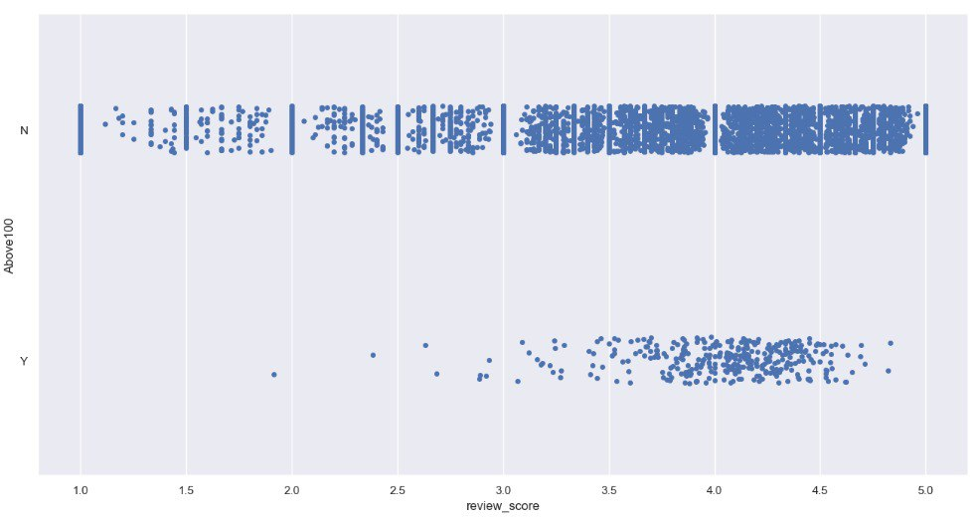
Exploratory Data Analysis
Notes:
Since we intend to maximise the sales count, we uses the 99 percentile value of 33 sales count for analysis.
Plotting it on a strip plot, we discovered that most products with above 33 sales count have better review score of more than 3.

Slide 12
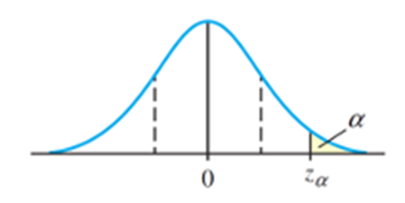
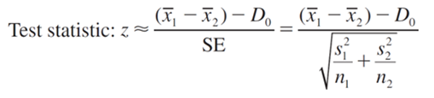
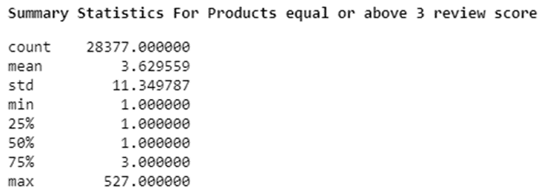
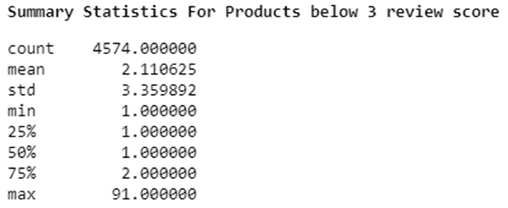
Exploratory Data Analysis
Large-Sample Statistical Test for (u1-u2):
Null hypothesis H0: (μ1-μ2) = 0
Alternative Hypothesis: (μ1-μ2) > 0
The results are highly significant!
Notes:
With the information, we split the data into review score of 3 and above, and below 3.
Using the Large-sample statistical test with the summary statistics of both data frame,
We are able to conclude that there are sufficient evidence to support that products with review score above 3 had higher sales count.
I will now hand over my time to Ten Wei, who will be focusing on the machine learning and key insights, before concluding our presentation.

Slide 13
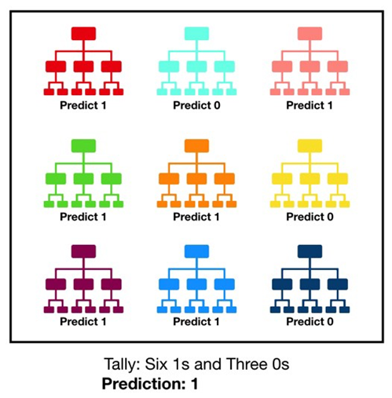
Machine Learning
Random Forest Classifier
Meta Estimator
Uses averaging
Better predictive accuracy
Control over-fitting
Notes:
In our project, we have adopted the random forest classifier as our model for machine learning.
By definition, a random forest is a meta estimator that fits a number of classifying decision trees on various sub-samples of the dataset and uses averaging to improve the predictive accuracy and control over-fitting.
As its name suggests, random forest consists of a large number of individual decision trees that operate as an ensemble. Each individual tree in the random forest spits out a class prediction and the class with the most votes becomes our model’s prediction as shown in the figure above.
A large number of relatively uncorrelated models (trees) operating as a committee will outperform any of the individual constituent models, and that is why we have chosen this machine learning model due to the large number of variables affecting the prediction of the review scores.

Slide 14
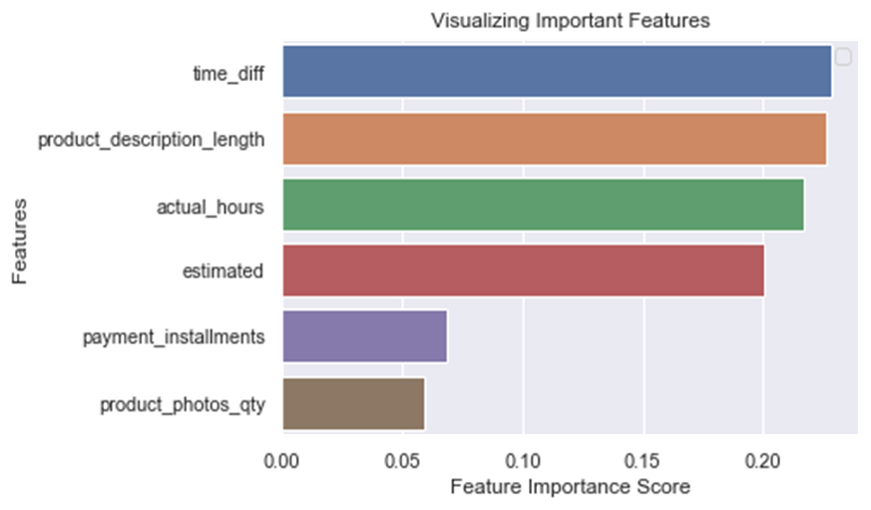
Machine Learning
Accuracy:
65.26%
Notes:
The variable used to predicts the review score includes: product description length, photo quantity, payment installments, estimated delivery duration, actual delivery duration as well as the time difference between estimated and actual duration.
After performing predictions on the test set, we obtained an accuracy of 65.2%.
By using random forests model, we learned that we are able to use the feature importance variable to observe the feature importance score.
With the information we are able to tell which features are most important in determining the forecast.
In our case, we learn that the time difference between the estimated and actual delivery time was the most important in predicting the review score.
This helps us understand the customers behaviour, and highlight the most important feature to the sellers to help them improve their review score which in turn maximise their sales.
And yes, using the random forest classifier has indeed solved our problem in predicting the customer’s review scores!

Slide 15
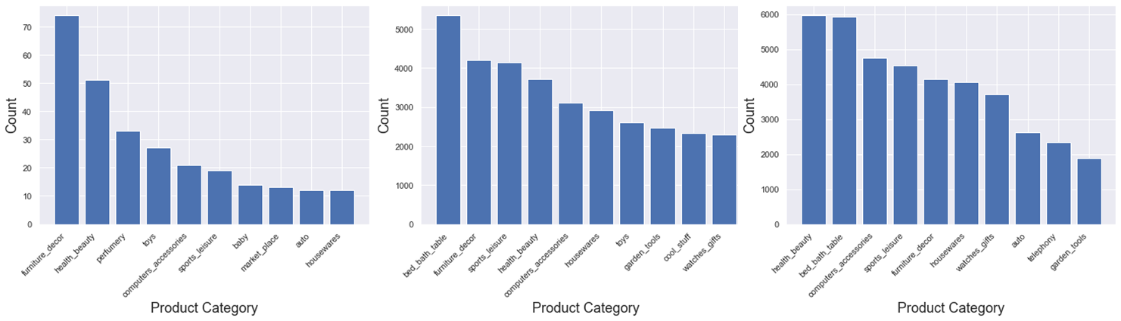
Insights
Top 10 Categories:
2016
2017
2018
Notes:
So other than predicting review score to help maximize sales, we discover other variable that can be use for recommendations.
Firstly we notice that the top categories change constantly along the years due to demand as well as new categories introduced. Thus, this keeps the sellers updated about the demands and trends.

Slide 16
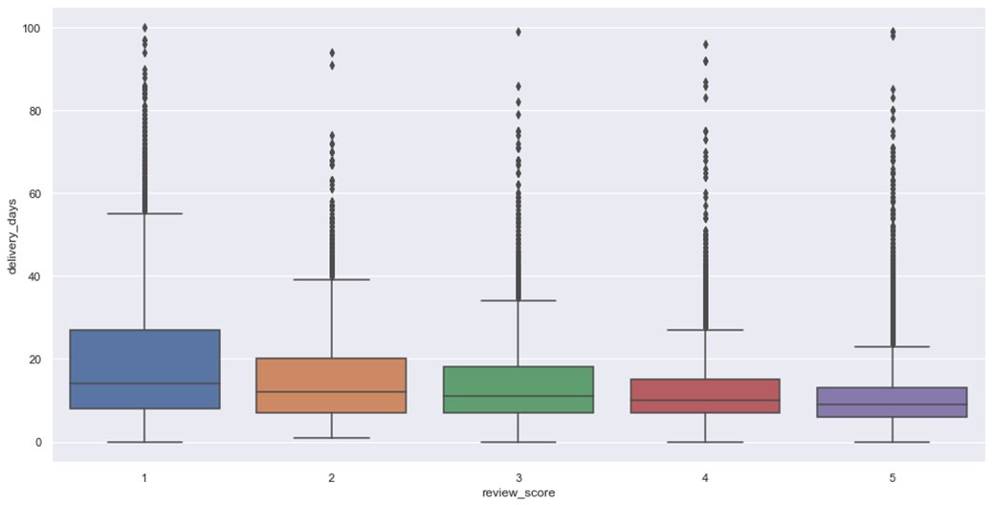
Insights
Faster delivery timing is related to higher review score (<26 days):
Notes:
Next, it was also observed that the range of delivery timing reduced with higher review score. Hence, we would recommend that less than 26 days of delivery time would increase the chances of getting better review scores.

Slide 17
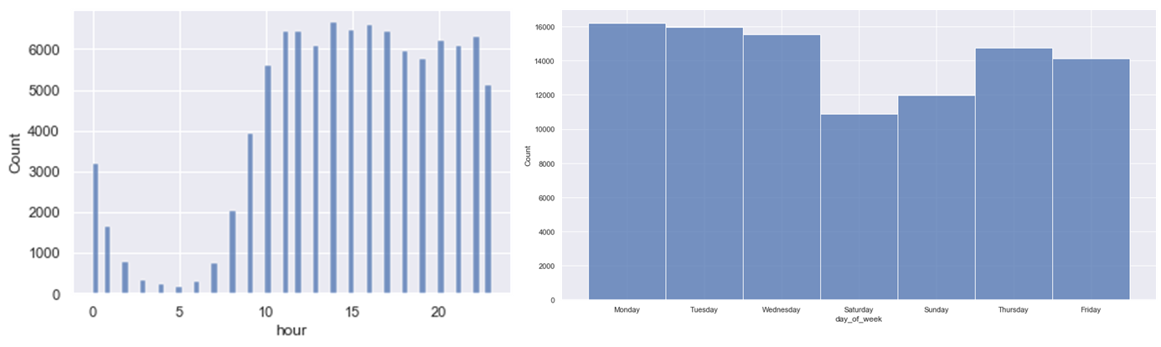
Insights
Customer Activity:
High traffic on Monday to Wednesday, 11 00 - 17 00
Notes:
Lastly, from the date and time data variable, we can also detect the period with highest customer activity. This may help sellers make better decision for promotions.

Slide 18
Conclusion
Minimize the gap between estimated delivery time and the actual delivery time.
Sellers can provide more detailed product descriptions to customers.
Sellers can market products from popular categories to increase sales.
To increase sales, promotions can be offered during off-peak hours.
Notes:
In Conclusion, our group has gathered a few key points for the sellers.

